Slide 1

PINS, Responses and Looping
Lesson 6

Slide 2
What the Lesson Will Cover
Be aware of the pins and some of their uses
Wire up a circuit using the pins and program a response
Apply understanding to build a simple alarm system
Notes:
Discuss that the micro:bit has a number of pins. Can the Learners locate them? Talk over some of the pins and what they do, the GND pin, power pins, input and output pins.

Slide 3
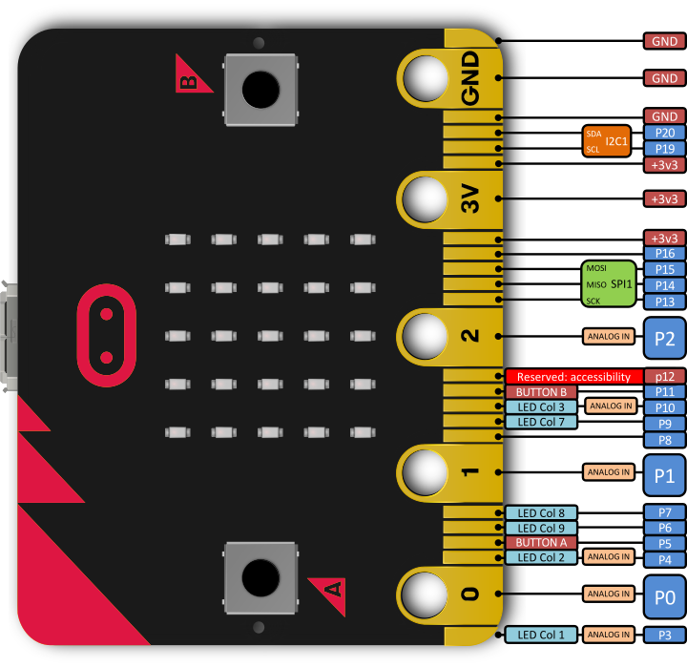
Pins
The pins enable you to add additional input, outputs and control to your micro:bit and programs
For example:
Attach a temperature sensor and write a program to respond to the readings
Attach a motor and power it via the 3V pin
Notes:
Discuss that the micro:bit has a number of pins. Can the Learners locate them? Talk over some of the pins and what they do, the GND pin, power pins, input and output pins.

Slide 4
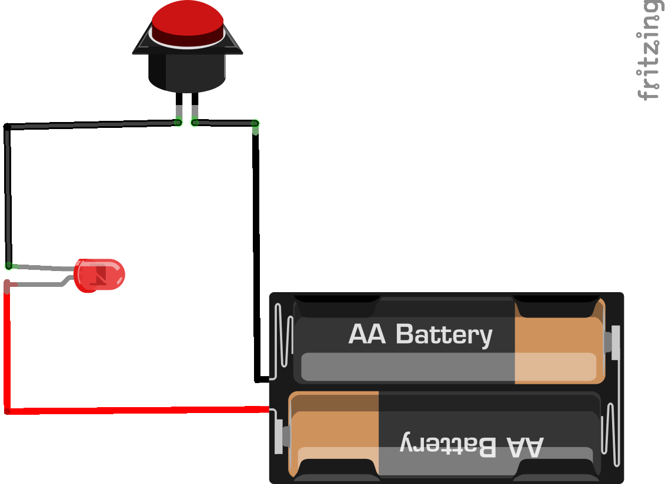
How Pins Work
Remember Lesson 4 where we looked at switches?
Switches can be used to open and close circuits
When the button is pressed the circuit is closed and the current can flow from the battery and power the light
Pins work like switches and buttons – when you join them together, usually with a wire, it closes the circuit and an event is triggered

Slide 5
Pins
The 5 main ring pins do the following:
Pin 0 – input
Pin 1 – input
Pin 2 – input
Pin 3 – provides a voltage of 3V
GND – grounds the pin to make the circuit
By using crocodile clips and joining Pin 0 and the GND it creates a circuit. Code can then be used to respond
Notes:
Discuss that the micro:bit has a number of pins, can the Learners locate them? Talk over some of the pins and what they do, the GND pin, power pins, input and output pins.

Slide 6
25 Additional Pins
The micro:bit also has 25 smaller pins
These pins range from providing
3V supply
Controlling the LEDs
Controlling the A and B buttons
Adding a crocodile clip to Pin 5 and joining it to the GND pin is the equivalent to touching Button A
Notes:
Discuss that the micro:bit has a number of pins. Can the students locate them? Talk over some of the pins and what they do, the GND pin, power pins, input and output pins.

Slide 7
Student Activity
Complete the first part of the Activity Sheet and create your own response to touching the pins
Notice that we use a while True loop to keep the program running
What would happen if we removed the loop?

